Slide 1
Apply of the CRISP-DM data mining methodology to analyze the data
Saiful Islam (10634911)
Ruhit Ahmed Rizon (10640049)
Sandra Sabu (10637636)

Slide 2
In this notebook we're going to apply the steps of the CRISP-DM data mining methodology to analyse the data
We will be using Neo4j Community Edition and perform EDA part using Python Py2Neo library
The dataset we choose for this project: Crime Investigation. Link: https://github.com/neo4j-graph-examples/pole

Slide 3
We have the following sections:
Business Understanding
Data Understanding
Data Preparation
Modelling
Evaluation
Deployment

Slide 4
Section-1: Business Understanding
Crime data for this demo was downloaded from public sources (http://data.gov.uk), and is freely provided for download with locations defined to the block or street level and crimes defined by month only (i.e. no day or timestamp). This public crime data does not include any sort of information about persons related to crimes, not even as anonymized tokens - it supplies only crime and location data, or in other words only the 'L' and 'E' for the POLE model. This demo uses street crime data for Greater Manchester, UK from August 2017.
Unique crime IDs, longitude, latitude, crime type, street/locale name, and last outcome values were taken from the public street crime data files. UK postcodes were retrieved from a public API using Longitude and Latitude, and randomly generated or curated data was used for other entities in the database (vehicles, officers, people, phone numbers, phone calls, emails, day of the month, etc.).

Slide 5
Section-1: Business Understanding
The different ways that Persons can be related to each other. There is a general 'KNOWS' relationship, as well as more specific relationship types: FAMILY_REL (related to), KNOWS_LW (lives with), KNOWS_PHONE (has a related phone call), and KNOWS_SN (social network).
Notice also that Location is associated to both Postcode and Area. In the UK, Postcodes follow a format which splits the postcode into two sections - for example, M1 1AA. In this example, 'M1 1AA' is the Postcode, and 'M1' is the area. This allows us to group locations in different ways, and build query paths that are either more specific (like Postcode, which is typically limited to a street or a few blocks) or more general (like Area, which could cover a town or city neighbourhood).

Slide 6
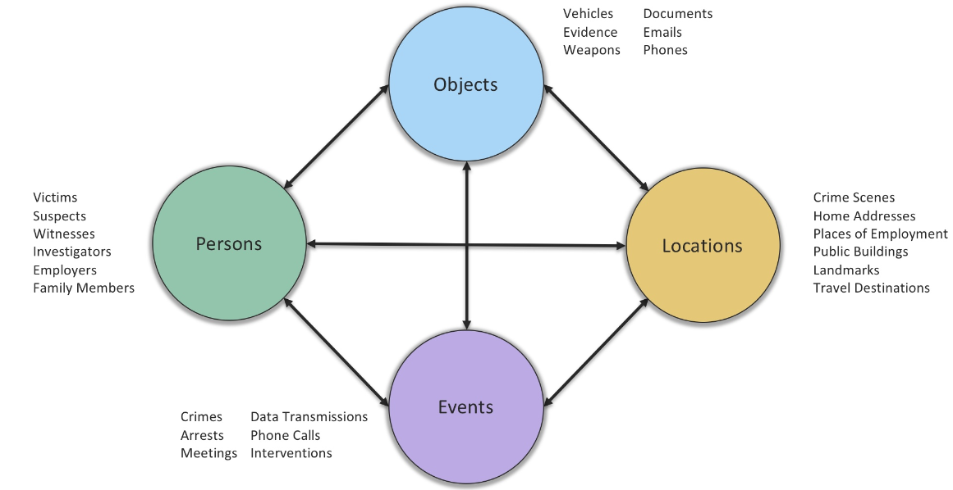
Section-2: Data Understanding
Crime Investigation dbms can be designed as POLE (Person, Object, Location, Events) model

Slide 7
Section-2: Data Understanding
POLE Model Use Cases
The POLE data model is a standard approach used in policing, investigative, and security use cases. It can also, however, be applied in other areas. Typical POLE use cases include:
Policing
Counter Terrorism
Border Control / Immigration
Child Protection / Social Services
Missing Persons
Offender Rehabilitation
Insurance Fraud Investigations
Graphs are a perfect fit for use cases like these, where it is important to be able to work with highly connected data in real time. Using a real-time graph helps investigators to be proactive and prevent crime or other incidents, rather than simply being reactive after an incident has occurred. A POLE graph can also be used to generate insights into patterns of behaviour and incidents, which can inform new approaches and enable more targeted use of limited resources.

Slide 8
Section-3: Data Preparation & EDA
Installing necessary libraries
!pip install py2neo pandas
!pip install py2neo pandas matplotlib

Slide 9
Loading necessary libraries
from py2neo import Graph
import pandas as pd
import matplotlib.pyplot as plt
plt.style.use('fivethirtyeight')
pd.set_option('display.float_format', lambda x: '%.3f' % x)
import pandas as pd

Slide 10
Loading the database into our local neo4j database
In this section, at first, we created a local database into our Neo4j Desktop named: stackoverflowdb. We choose the db version: 5.5.0
Then apply the following credentials to connnect to our local database:
graph = Graph("bolt://localhost:7687", auth=("neo4j", "12345678"))
After that, we downloaded the crime investigation repo from https://github.com/neo4j-graph-examples/pole
After extracting the zip file, pole-50.dump from data folder has been loaded into neo4j desktop. Then database has been created from the dump file.

Slide 11
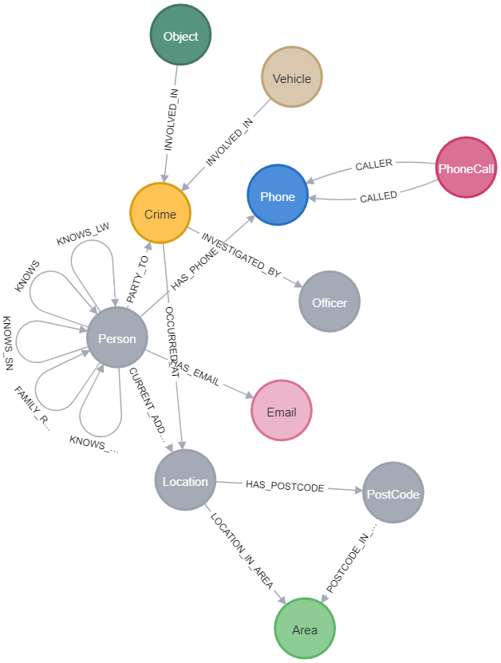
Schema visualization
Query = “CALL db.schema.visualization()”

Slide 12
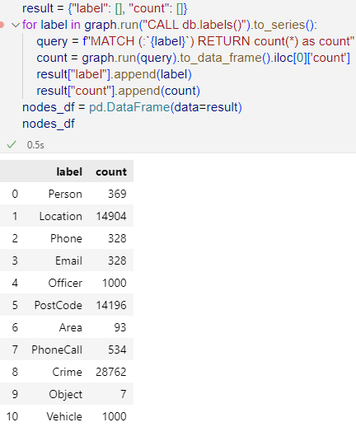
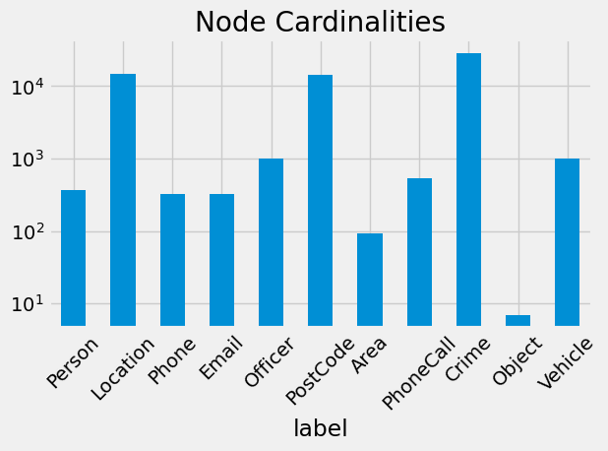
No of nodes per label

Slide 13
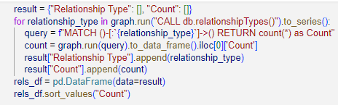
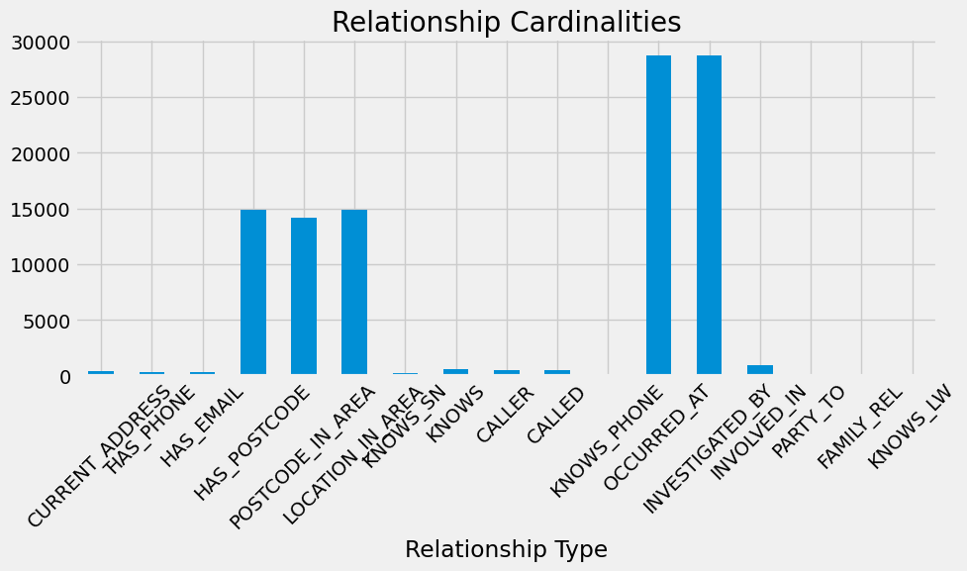
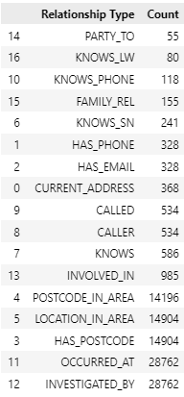
List of types of relationships

Slide 14
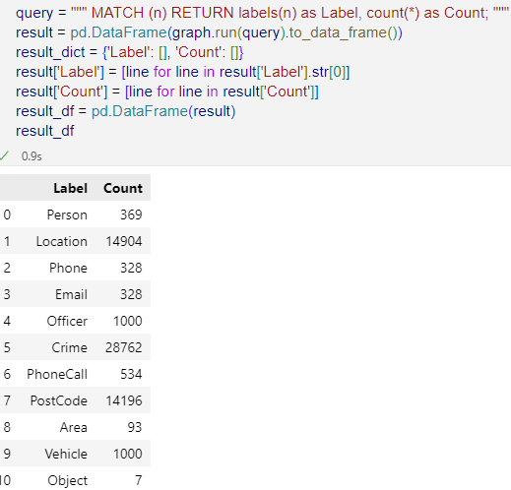
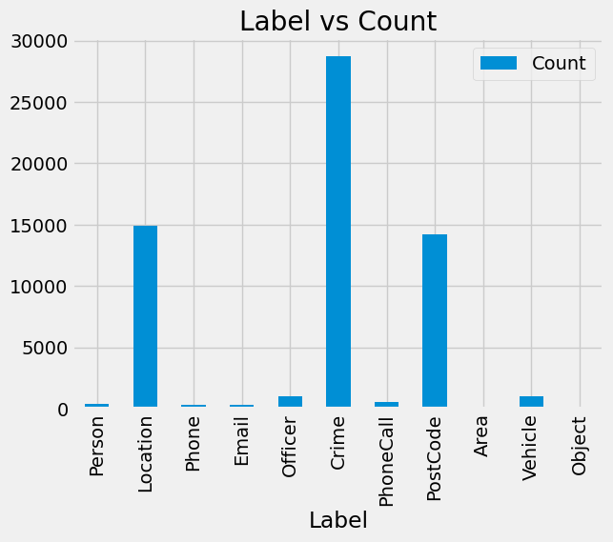
List of labels

Slide 15
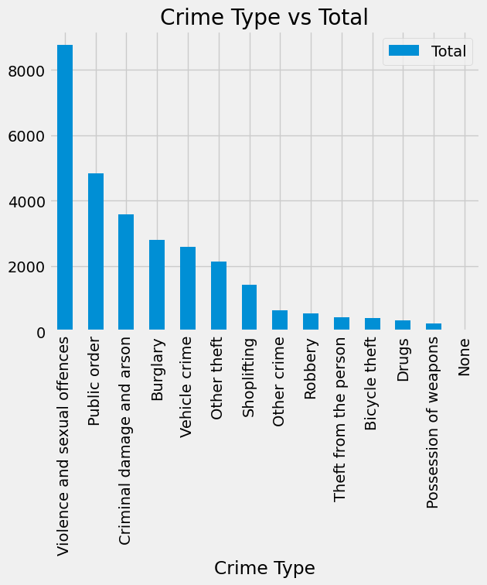
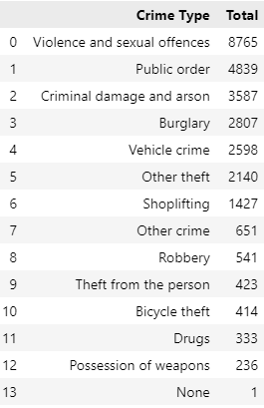
Total Crimes

Slide 16
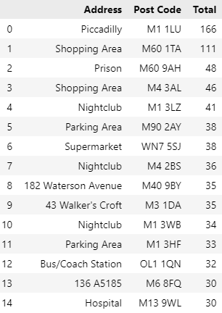
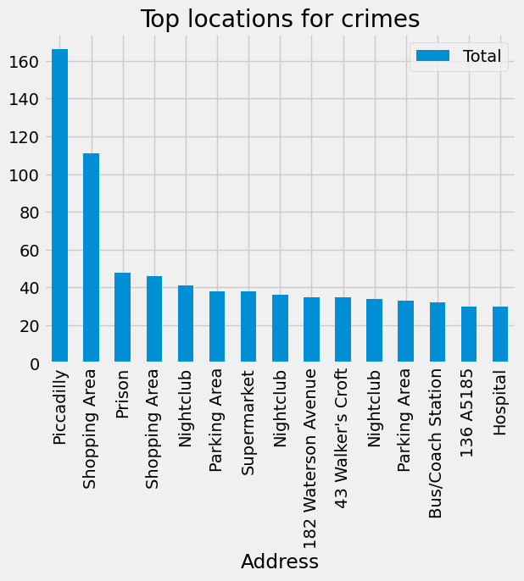
Top locations for crimes

Slide 17
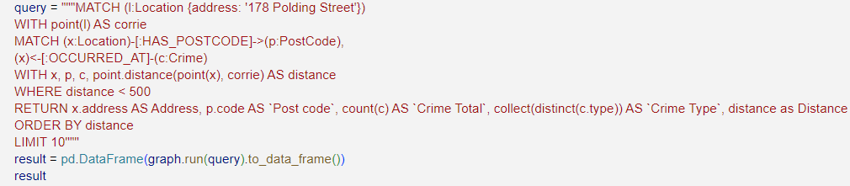
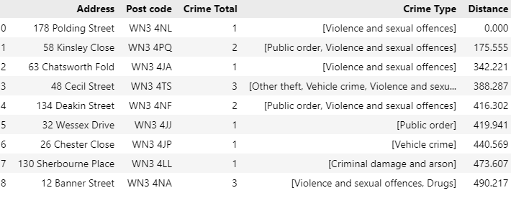
Crimes near a particular address

Slide 18
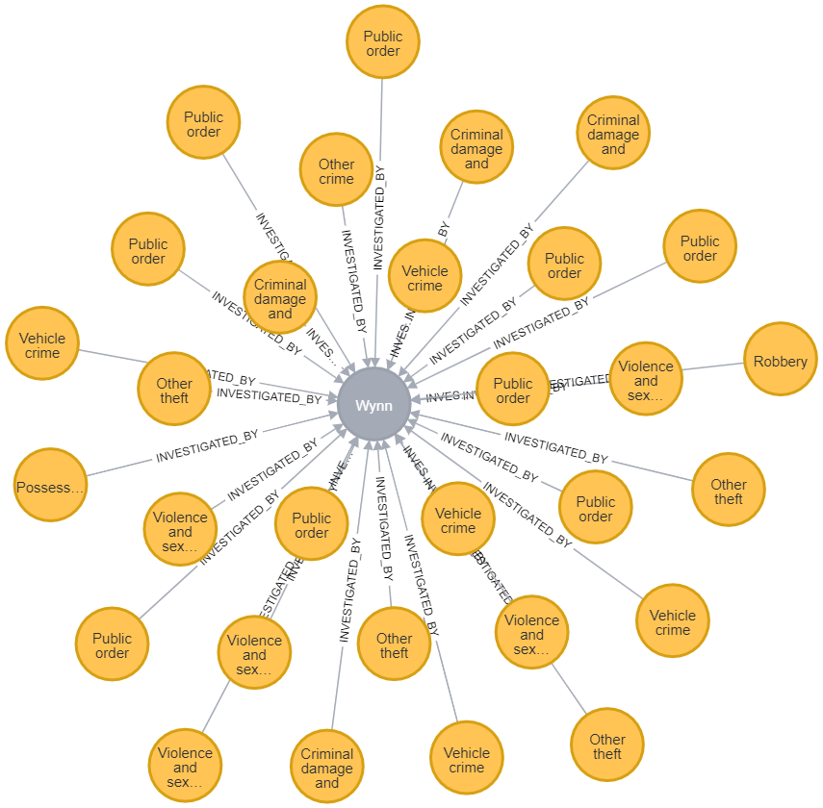
Crimes investigated by Inspector Wynn
MATCH (o:Officer {rank: 'Chief Inspector', name: 'Wynn'})<-[i:INVESTIGATED_BY]-(c:Crime) RETURN *

Slide 19
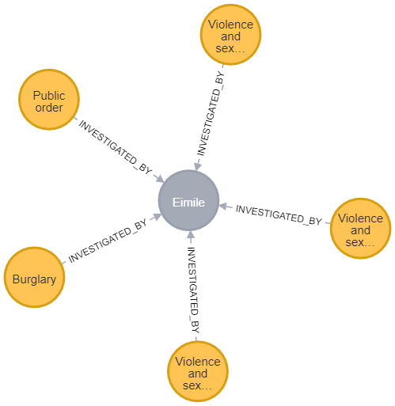
List of cases being investigated by officer Eimile
MATCH (c:Crime {last_outcome: 'Under investigation'})-[i:INVESTIGATED_BY]->(o:Officer {badge_no: '18-0221971', name: 'Eimile'})
return *

Slide 20
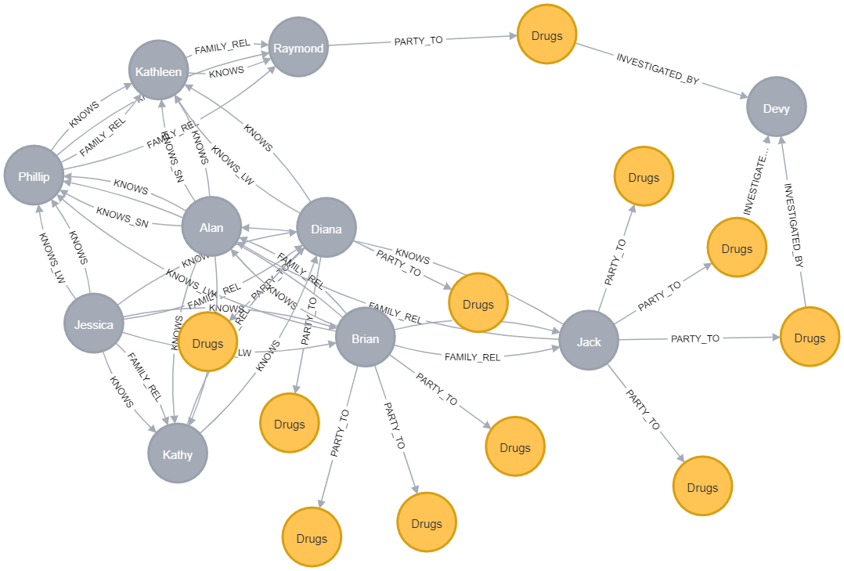
Related people associated with drugs crimes
MATCH path = (:Officer {badge_no: '26-5234182'})<-[:INVESTIGATED_BY]-(:Crime {type: 'Drugs'})<-[:PARTY_TO]-(:Person)-[:KNOWS*..3]-(:Person)-[:PARTY_TO]->(:Crime {type: 'Drugs'}) RETURN path

Slide 21
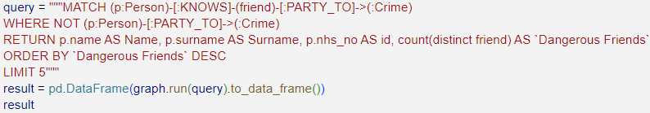
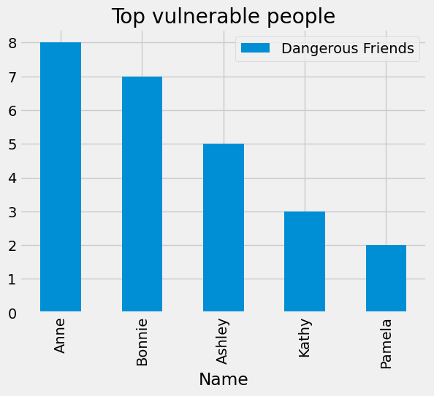
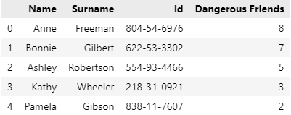
Top people at risk of being associated with crimes in future

Slide 22
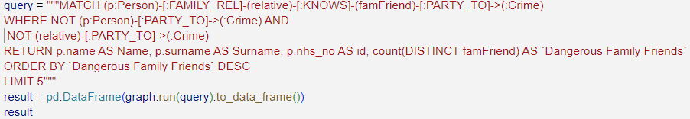
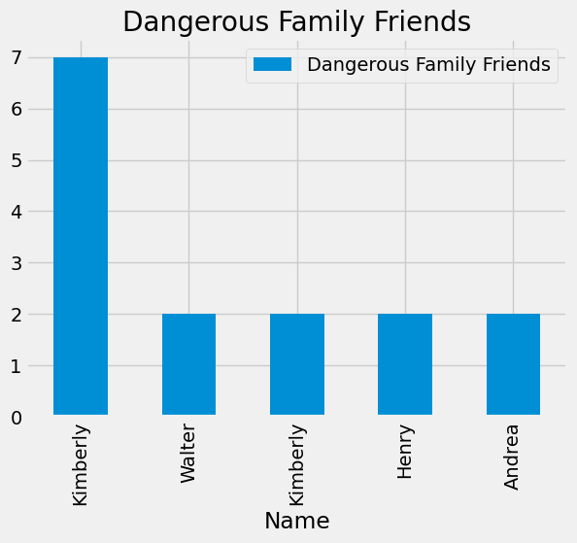
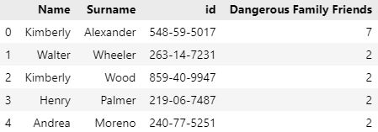
Dangerous Family Friends

Slide 23
Section-4: Modelling - Implementation of Graph algorithms
In this section, we will be applying
Degree Centrality
Closeness Centrality
Betweenness Centrality
Eigenvector Centrality
PageRank

Slide 24
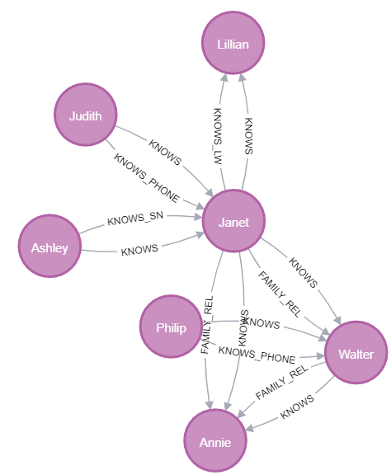
Showing the results of the graph by selecting a specific person having relation with others. Here we run the below query and set the limit into 25. So in this 25 nodes, only 7 nodes has relation with the given node. so it is showing 7 nodes.
MATCH path = (:Person {nhs_no: '863-96-9468', surname: 'Duncan'})-[:KNOWS*..3]-(:Person)
WITH nodes(path) AS allNodes
UNWIND allNodes AS node
RETURN node
LIMIT 25;

Slide 25
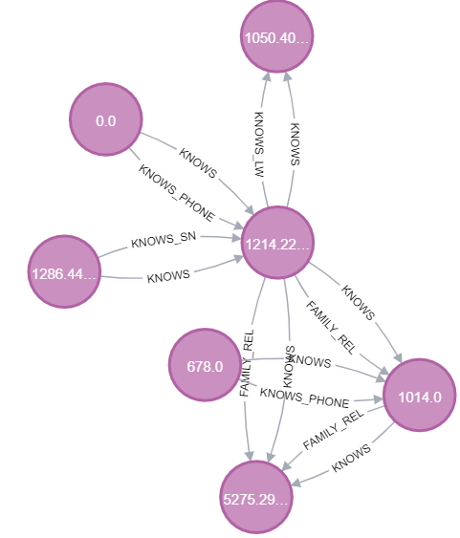
Computing Betweenness Centrality Algorithm
CALL gds.betweenness.write('social', { writeProperty: 'betweenness' })
YIELD centralityDistribution, nodePropertiesWritten
RETURN centralityDistribution.min AS minimumScore, centralityDistribution.mean AS meanScore, nodePropertiesWritten;

Slide 26
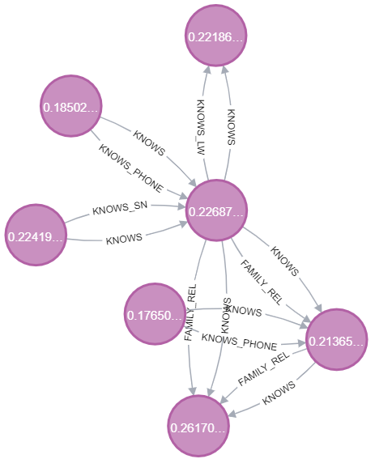

Computing Clossness

Slide 27
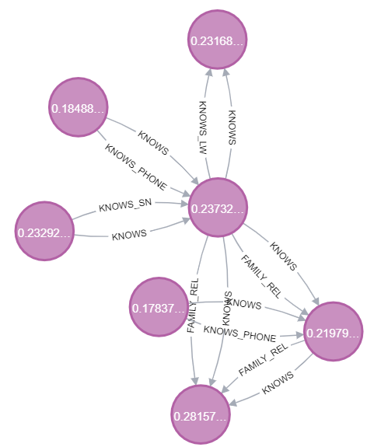
Computing Harmonic Closeness
graph.run("""
CALL gds.alpha.closeness.harmonic.write('social',{writeProperty: 'harmonic'});
""").to_data_frame()

Slide 28


Computing PageRank
graph.run("""
CALL gds.pageRank.write('social', {
maxIterations: 20,
dampingFactor: 0.85,
writeProperty: 'pagerank'
})
YIELD nodePropertiesWritten, ranIterations;
""").to_data_frame()

Slide 29
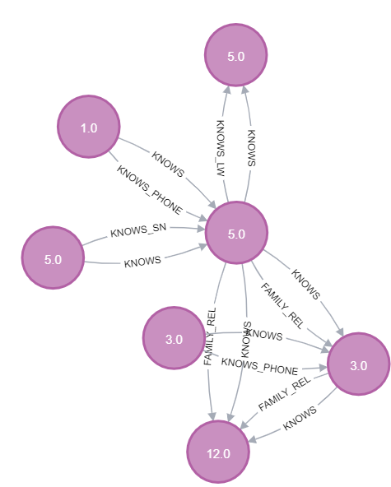
Computing Degree Centrality
graph.run("""
CALL gds.degree.write('social', {writeProperty: 'degree'});
""").to_data_frame()

Slide 30
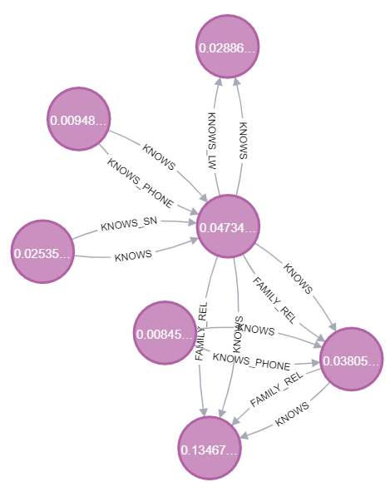

Computing EigenVector
graph.run("""
CALL gds.eigenvector.write('social', {
maxIterations: 20,
writeProperty: 'eigencentrality'
})
YIELD nodePropertiesWritten, ranIterations;
""").to_data_frame()

Slide 31
Section-5: Evaluation
After performance analysis on our data, we can interpret that weighting for our searches and algorithms - for example, some crimes might be considered more dangerous than others (i.e. Violence and Sexual Offences is more serious than Shoplifting), or some relationships might be considered more reliable or closer (i.e 'Family' or 'Lives With' could be weighted more than 'Social Network')

Slide 32
Section-6: Deployment
In terms of Artificial Intelligence of our domain problem, our derived graph algorithms can be applied to standard approach used in policing, investigative, and security use cases standard approach used in policing, investigative, and security use cases like:
Policing
Counter Terrorism
Border Control / Immigration
Child Protection / Social Services
Missing Persons
Offender Rehabilitation
Insurance Fraud Investigations
We can predict which location has higher probability of occurring a crime, which person is at venerable condition, that is at higher risk of being indulge in criminal activities in near future.

